Slide 1

Birla Institute of Technology, Mesra
TOPIC : Watermarking Algorithm based on Spread Spectrum Technique
Mentor : Dr Sumit Srivastava
TEAM MEMBERS
PRAKHAR KUMAR SINGH (BTECH-10031-20)
ANKIT GHOSH (BTECH-10185-20)
SAMEER DAMKONDWAR (BTECH-10239-20)

Slide 2
OBJECTIVE
This paper proposes an audio watermarking algorithm that aims to protect owners' audio materials from illegal copyright infringements while ensuring the audio remains imperceptible.
The subsequent sections will provide a detailed explanation of the proposed algorithm, experimental results, future scopes, ultimately demonstrating its effectiveness and practicality in real-world scenarios.
We shall see in detail the embedding algorithm, the extracting algorithm and the experimental results that will show the effectiveness of the proposed algorithm.

Slide 3
MOTIVATION & BACKGROUND
Protection against copyright infringement: With the ease of digital reproduction and distribution, audio content creators face the challenge of protecting their work from unauthorized copying and distribution..
Detection and deterrence of piracy: Audio watermarking techniques allow for the detection of illegally distributed or shared audio content. By embedding watermarks that can be extracted and analyzed, copyright holders can identify the source of unauthorized leaks and take appropriate legal action
Forensic applications: Audio watermarking plays a crucial role in forensic investigations, such as in cases involving audio tampering, voice forgery and help to establish the authenticity and integrity of audio recordings, providing valuable support in legal proceedings.
Steganography is a concept that can be used to conceal almost any type of digital content, including text, image, video or audio content; the data to be hidden can be hidden inside almost any other type of digital content.

Slide 4
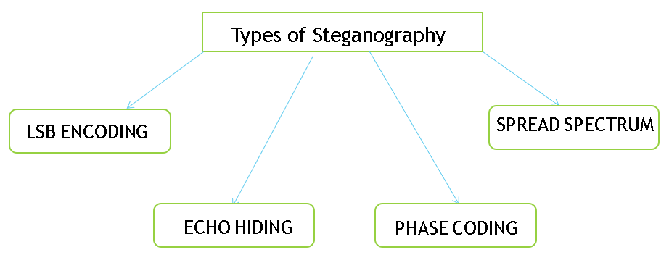
Steganography
Steganography is the practice of concealing information within another medium in order to keep it hidden from unauthorized individuals.

Slide 5
TYPES OF STEGANOGRAPHY
LSB Encoding: LSB encoding is a steganography technique that conceals data within the least significant bits of a digital signal, such as an image or audio file, without significantly affecting its perceptual quality.
Phase Encoding: Phase encoding is a modulation technique in digital communications where information is encoded by manipulating the phase of a carrier signal, allowing for the transmission of digital data over a communication channel.
Echo Hiding: Echo hiding is an audio steganography technique that involves embedding imperceptible echoes in an audio signal, altering the delays and intensities of the echoes to conceal data within the audio, enabling covert communication or watermarking of the audio

Slide 6
TYPES OF STEGANOGRAPHY
Spread spectrum: Spread-Spectrum is a technology that modulates a signal over many carrier frequencies at once.
It involves spreading the hidden data across a wide range of frequencies. The carrier signal is modified by modulating it with the secret information.
By distributing the hidden data across multiple frequencies, it becomes robust against detection and removal attempts.
Spread spectrum steganography is resistant to noise, interference, and compression. It can be applied to various types of signals, including audio, images, and video.
This technique enables covert communication and data protection. It takes advantage of the deliberate spreading of the signal over a larger bandwidth than necessary.
The hidden data is difficult to detect as it appears as slight modifications in the carrier signal.
We have used the spread spectrum technique for the watermarking algorithm that we have proposed in this paper.

Slide 7
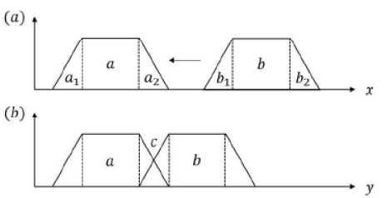
Methodology: WSOLA Algorithm
Waveform Similarity Overlap and Add is as shown figure (a) x in the figure is the audio input without speed change, figure (b) y in the figure is the audio output after x speed change. First, process the first frame, copy the data of area a to output y, and then a₂ , and b₁ , data is superimposed, the superimposed result C is copied to output y , and finally the data of area b is copied to output y, that is, the processing of one frame is completed. The algorithm in this chapter selects the non-overlapping regions in each frame for operation, such as region a and region b.

Slide 8
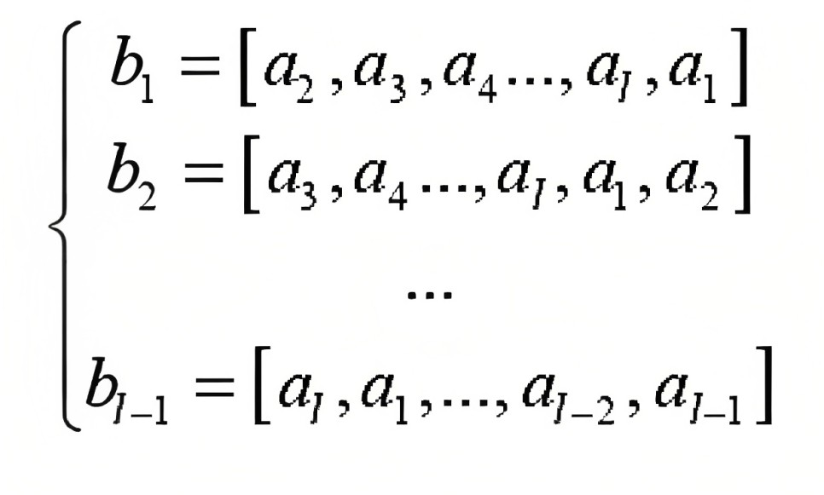
Methodology: Embedding Algorithm
The total length of the watermark sequence is w_{N}. Each time a b-bit watermark is embedded, the b-bit binary may form 2^{b} different sequences. Therefore, if a pseudo-random sequence is used to represent each embedded b-bit watermark sequence, a total of 2^{b} different pseudo-random sequences are required.
Randomly generate a sequence b₀ = [a₁,a₂,...a_{l}] , where l=2^{b} ,
a_{i} ∈ {-1,1}, i=1,2,…l. For sequence b₀ is circularly shifted to get
the rest of the random sequences as shown in the figure:

Slide 9
Methodology: Embedding Algorithm
Perform Schmidt orthogonalization on the matrix to obtain an orthonormal matrix P. Schmidt orthogonalization is a process that transforms a set of vectors into an orthonormal set by iteratively subtracting the projections of the vectors onto the previously computed orthogonal vectors
Apply the Discrete Cosine Transform (DCT) to the non-overlapping parts of each audio frame. The DCT transforms the time-domain audio signal into the frequency domain. By doing this we can do the embedding of the watermark in the frequency domain in the following steps.

Slide 10
Methodology: Embedding Algorithm
For each frame, perform the following steps, to implement the embedding formula, to embed the watermark information where s₀ = embedding strength parameter
y_{i} = x_{i} + s₀ . sgn(x_{i} . p_{t}^{T})p_{t}
Obtain the DCT coefficients of the frame, denoted as x₁,x₂,...x_{N}.
Retrieve the corresponding pseudo-random sequence from p₁,p₂,...p₂^{b}, based on the frame index.
Compute the inner product of x_{i} and the selected pseudo-random sequence p_{t}.
Modify the DCT coefficient x_{i} by adding the product of s_{0,} the signum value, and the selected pseudo-random sequence p_{t}.
Repeat steps a to e for each frame.

Slide 11
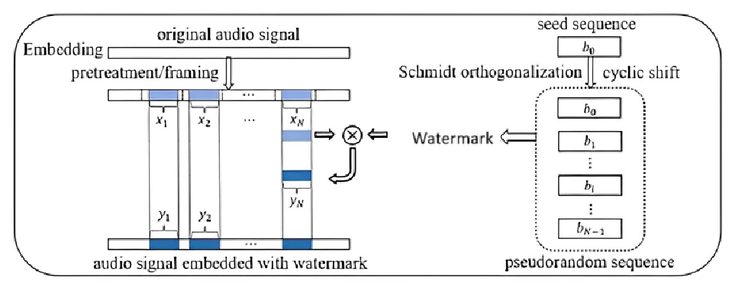

Methodology: Embedding Algorithm
After embedding the watermark into all the audio frames, perform the inverse DCT (IDCT) transform on each frame to obtain the modified audio segments.
Reconstruct the watermarked audio signal by combining the modified audio segments.

Slide 12
Methodology: Extracting Algorithm
The algorithm describes the process of extracting a watermark from an audio signal using a watermark embedding method based on the WSOLA (Waveform Similarity Overlap and Add) algorithm. Here is the step-by-step explanation of the algorithm:
Next, the algorithm performs Schmidt orthogonalization on the matrix P. Which is same as generated as in the embeding process. To obtain these sequences, a seed sequence b₀ is cyclically shifted to generate b₀,b₁,....b_{l-1}.
The algorithm begins by determining the position of the watermark in each frame of the audio signal.
In this step, the algorithm applies the Discrete Cosine Transform (DCT) to the area of interest in each frame. The DCT transformation converts the audio samples into a set of DCT coefficients, represented as vector y₁,y₂,...y_{N}.

Slide 13

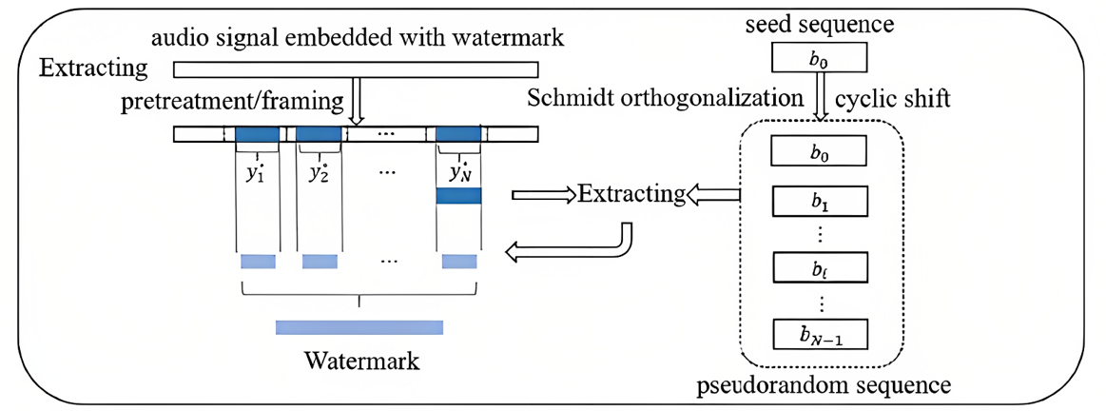
Methodology: Extracting Algorithm
Finally, the watermark is extracted from each frame using the extraction formula provided. For each frame, the algorithm computes the correlation between the pseudo-random watermark sequence vectors and the transformed audio vectors. The correlation is calculated using the formula:
t_{i}= arg max |y_{i}p^{T}_{j} | where j ∈ {1,2,…,2^{b}}
By performing these steps on each frame of the audio signal, the algorithm extracts the watermark embedded in the audio. The watermark extraction process is the reverse of the watermark embedding process, allowing the original watermark information to be retrieved from the watermarked audio.

Slide 14
Experimental Environment
Experimental environment:
11th Gen Intel Core i5, 2.40 GH z - x64 processor, 8 GB RAM, 64-bit operating system
Algorithm Language:
MATLAB
Experimental Audio:
We used multiple WAV file viz. sample1.wav, sample2.wav, sample3.wav, sample4.wav & sample5.wav for the experiment.

Slide 15
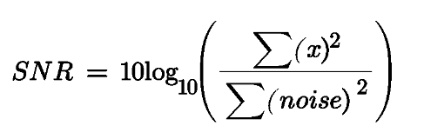
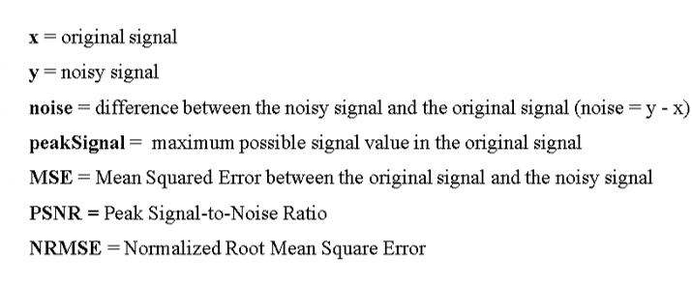
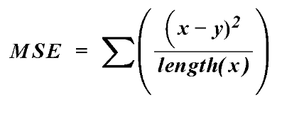
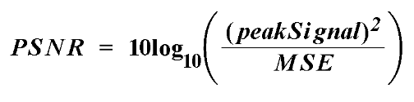
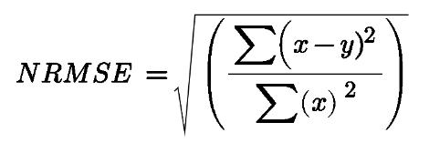
Experimental Results
Imperceptibility refers to the absence of noticeable distinctions between the original audio, free of any watermark, and the audio containing an embedded watermark. In other words, the process of embedding an audio watermark should not affect the quality or value of the audio content. The Signal-to-Noise Ratio (SNR) serves as the benchmark for evaluating the imperceptibility.
The SNR (Signal-to-Noise Ratio) measures the level of audio distortion that occurs when a watermark is embedded. A higher SNR indicates lower audio distortion, meaning that the watermark is more imperceptible. In the formula, x̄ represents the original audio signal, and x̂ represents the audio signal with the embedded watermark

Slide 16
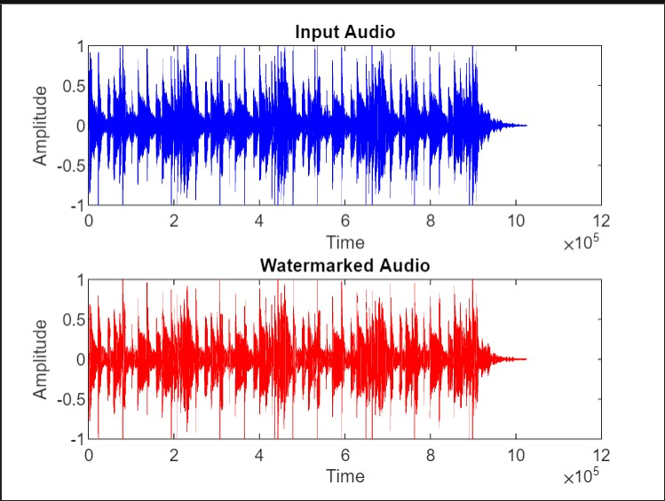
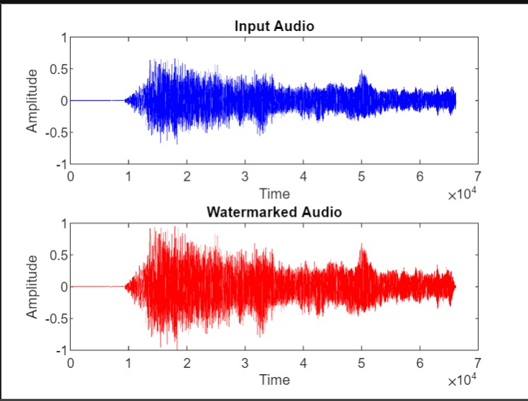


Experimental Results
We performed the embedding algorithm on the different audio files and obtained the results presented in Table 1. Based on our findings, we can conclude that the algorithm demonstrated imperceptibility:

Slide 17
Experimental Results
We performed the embedding of a watermark on five different audio samples listed above. The findings of the embeddings are provided in the
Algorithm | Audio | SNR | PSNR | NRMSE
DCT | sample1.wav | 40.20 dB | 13.99 dB | 0.34
 | sample2.wav | 45.15 dB | 28.50 dB | 0.33
 | sample3.wav | 46.30 dB | 15.63 dB | 0.45
 | sample4.wav | 26.21 dB | 15.23 dB | 0.63
 | sample5.wav | 21.56 dB | 12.14 dB | 0.52

Slide 18
Conclusion & Future Scope
This paper describes an audio watermarking algorithm that utilizes the WSOLA algorithm to resist variable speed attacks. It incorporates a spread spectrum-based pseudo-random sequence to enhance the randomness and robustness. The WSOLA algorithm analyses the relationship between the audio before and after the speed change to identify invariants for watermark embedding and extraction.
The robustness and the randomness of the algorithm holds the key for success in the future prospects of copyright protection. As we are headed to an era of cyber warfare, where future wars will be fought over acquisition of data, our algorithm, in a small manner, will contribute to preparing defenses against future attacks. Even if someone attempts to tamper with the audio speed, the watermark will remain intact, which can be used to prove the ownership of the real owner during legal trials. In short, we have made a small attempt to secure the ownership of the real owners over the work they do with their sheer hard work and dedication, so that they get their due credits.

Slide 19
References
G. Hua, J. Huang, Y.Q. Shi, "Twenty years of digital audio watermarking - a comprehensive review," Signal Processing, 2016.
D. Torrieri, "Principles of spread-spectrum communication systems," pp. 87-154, 2015.
D. Jonathan, M. Meinard, "A Review of Time-Scale Modification of Music Signals," Applied Sciences, 2016, 6(2):57.
S. Grofit, Y. Lavner, "Time-scale modification of audio signals using enhanced WSOLA with management of transients," IEEE Trans. Audio Speech Lang. Process. 2008, 16, 106-115.
S. Grofit, Y. Lavner, "Time-scale modification of audio signals using enhanced WSOLA with management of transients," IEEE Trans. Audio Speech Lang. Process. 2008, 16, 106-115.
H. S. Malvar and D. A. Florêncio, "Improved spread spectrum: A new modulation technique for robust watermarking," IEEE Transactions on Signal Processing, vol. 51, no. 4, pp. 898-905, 2003.
A Valizadeh and Z. J. Wang, "An improved multiplicative spread spectrum embedding scheme for data hiding," IEEE Transactions on Information Forensics and Security, vol. 7, no. 4, pp. 1127-1143, 2012.

Slide 20
THANK YOU

